Slide 1
Introduction to materials physics #4
Week 4: Application of electromagnetic interaction

Slide 2
Chap. 1-3: Table of contents Application of electromagnetic interaction
Review of the last week
Mutual relation among optical, electric and atomic properties
Absorption and emission of light
Spectroscopy
Atomic resonance and Line spectrum
Optical memory
Magnetooptic effect
Faraday effect, Kerr effect

Slide 3
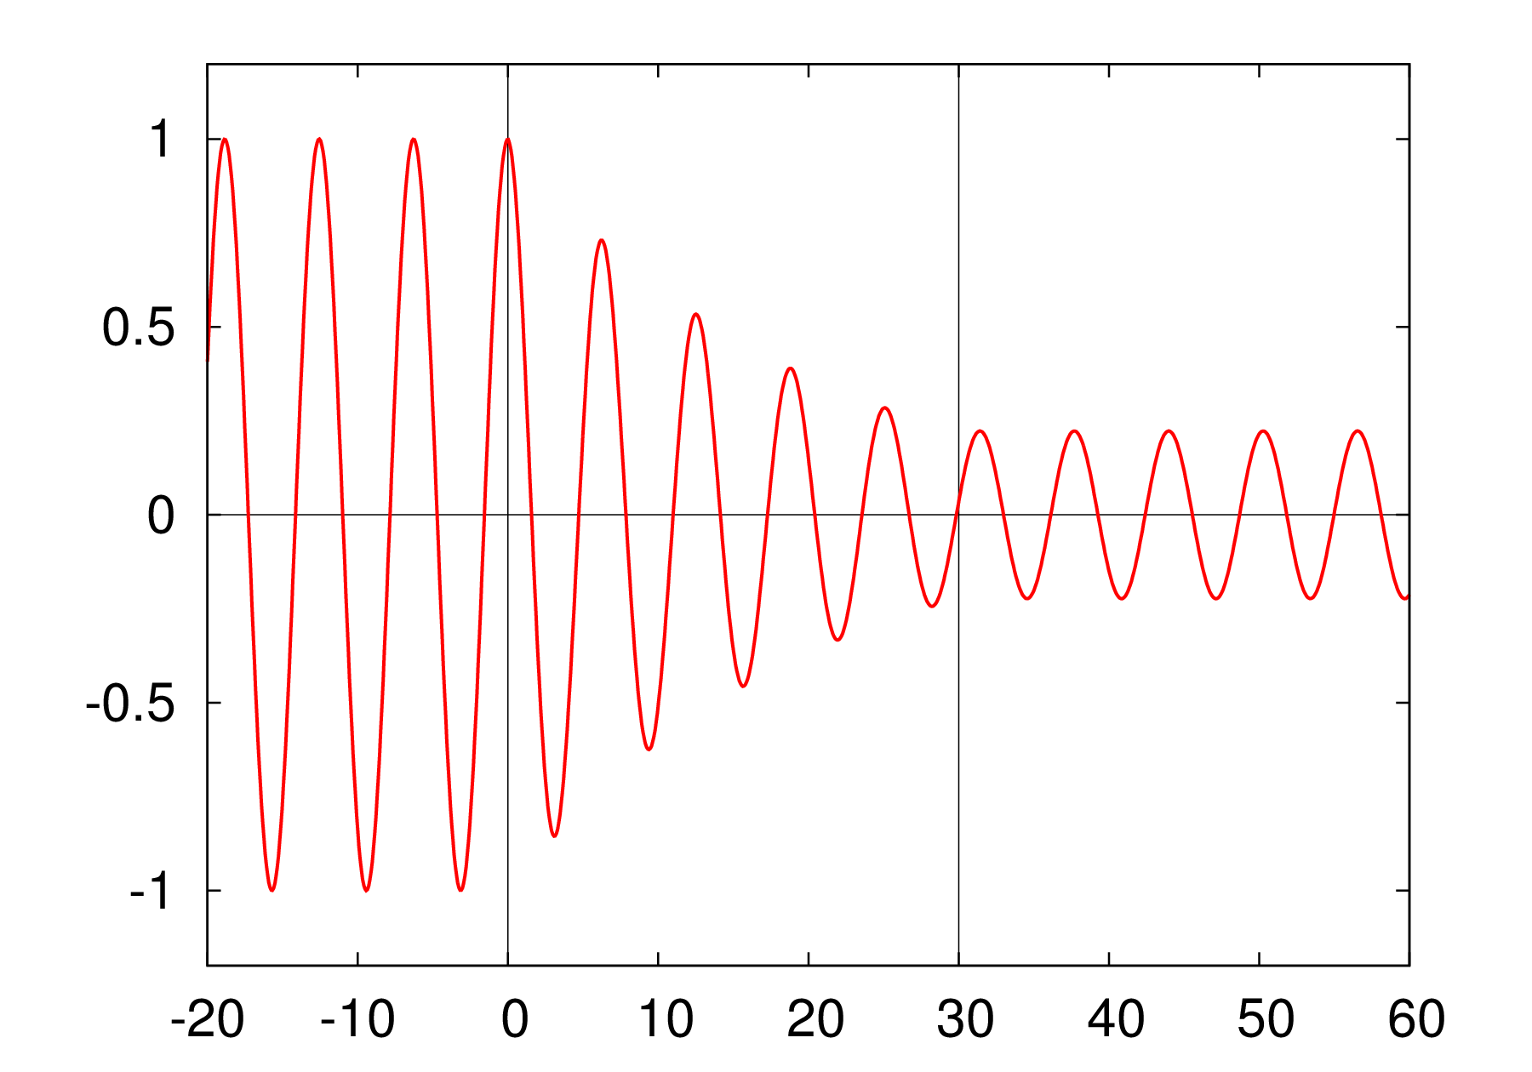
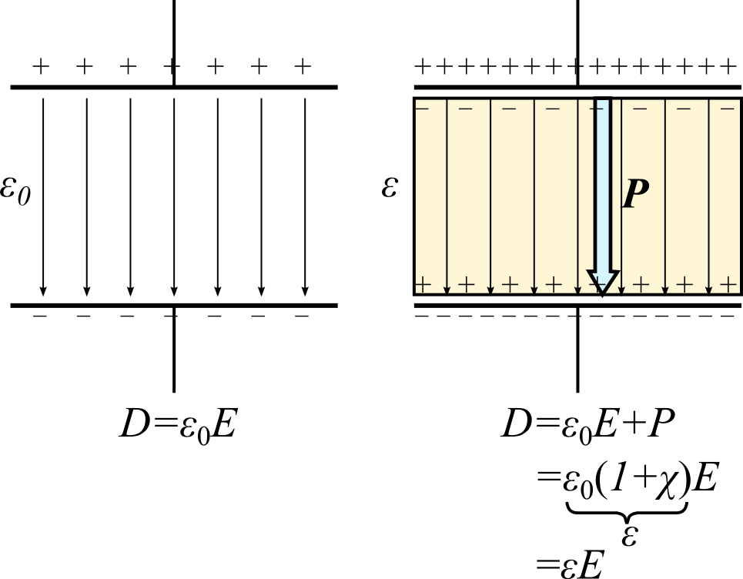
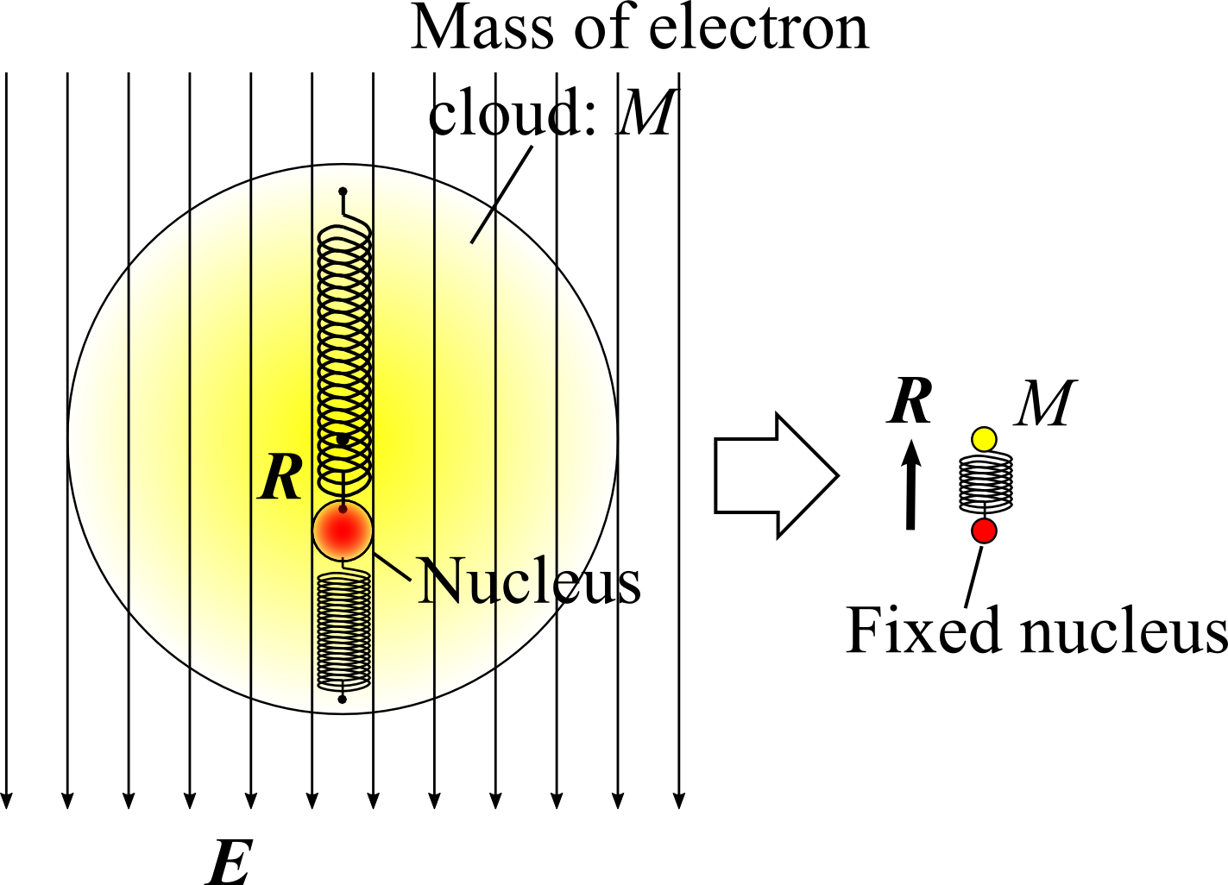
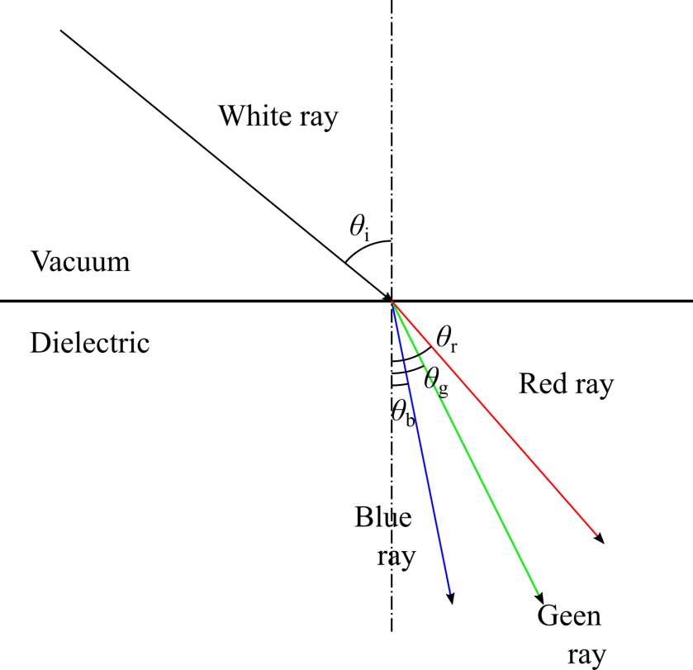
1. Review of mutual relation among optical, electric and atomic properties
Optical property
Refractive index
n’ : Refraction
n” : Absorption
Electric property
(Dielectricity)
Electric susceptibility
χ’ : Real part
χ” : Imaginary part
Atomic property
Electric dipole moment
of atom
ω₀: Resonance
frequency
Γ : Damping constant

Slide 4
Optical measurement
Measurement of absorption and refraction of light can probes the property of atoms (resonance frequency, damping constant) via electric property.
“Optical measurement” “Spectroscopy”

Slide 5
2. Absorption and emission of light
Interaction between light and atoms
Absorption: light & ground atoms exits.
Atoms absorb light. ⇒ “Absorption of light”
Spontaneous emission: no light & excited atoms exist.
Atoms emit light randomly. ⇒ “Spontaneous emission of light”
Induced emission: light & excited atoms exist.
Atoms emit light with the same property as incident light. ⇒ “Induced emission of light”

Slide 6
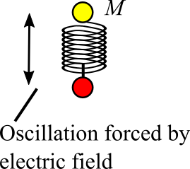
1. Absorption of light
Incident light forces atoms to oscillate, so that the energy of light is transported to atoms.
Electromagnetic wave
Work
Oscillatory motion of atom (Atoms are excited)
Work
Energy damping of oscillation

Slide 7
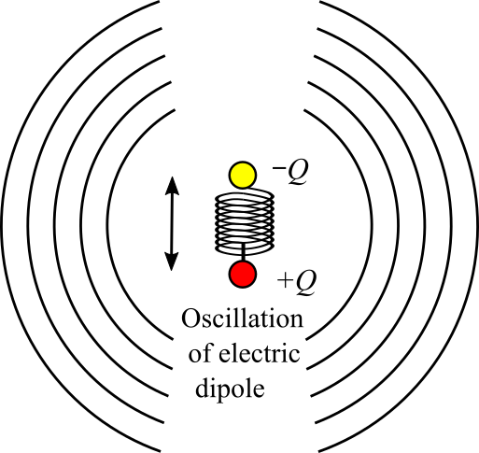
2. Spontaneous emission of light
Oscillatory motion of electric dipole acts as a “dipole antenna”.
⇒ Emission of light
Oscillatory motion of electric dipole
Work
Emission of electromagnetic wave (light)
Energy damping of oscillation

Slide 8
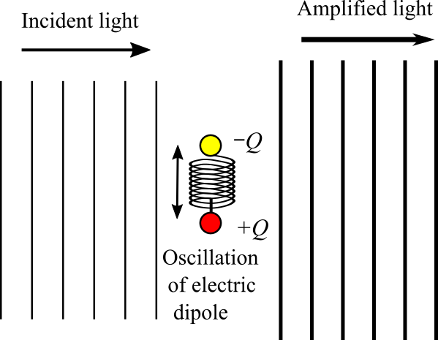
3. Induced emission of light
When both of an incident light and excited atoms exist, atoms emit light into the direction of the incident light.
⇒ Incident light is
amplified.
Light Amplification by Stimulated Emission of Radiation
LASER
* “Induced emission” can not be understood intuitively. You might meet this subject in “Quantum electronics”.
* “Induced” = “Stimulated”

Slide 9
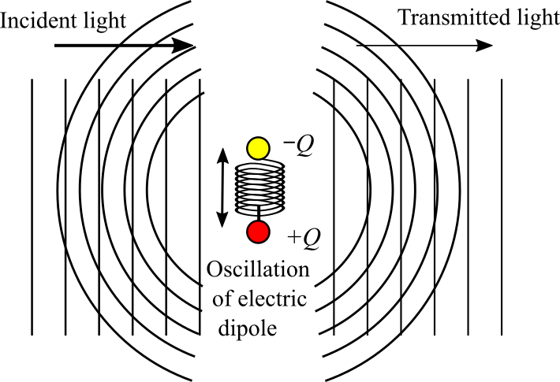
All cases
All the incident light, excited atoms and ground atoms exist, all the processes occurs.
Incident light is absorbed by atoms. ⇒ Absorption of light
Atoms are excited. ⇒ Oscillatory motion
Both the spontaneous emission and induced emission take place.
Spontaneous emission
Absorption
Energy of oscillation of atoms
Energy of
incident light
Induced emission
Transmission
Transmitted light

Slide 10
3. Spectroscopy
Spectroscopy is optical measurement to probe properties of atoms.
Absorption and refraction ⇒ n’ and n”
Measured as a function of the frequency ω (or wavelength λ) of interacting light
Properties of atoms

Slide 11
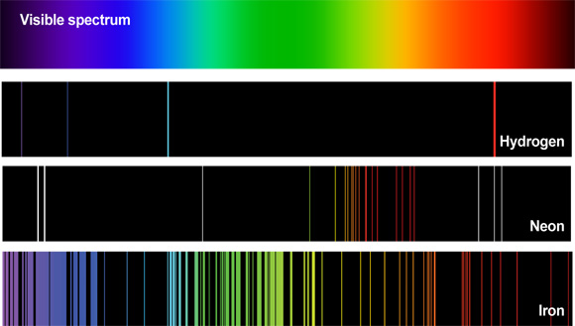
Rydberg formula and Bohr model
Atoms absorb or emit light only with some particular frequencies ω₀. ⇒ Line spectrum
Rydberg found the experimental formula from experimental results of ω₀.
http://www2.ifa.hawaii.edu/newsletters
/article.cfm?a=517
*Original Rydberg constant R is defined as R=hc R_{y}.

Slide 12
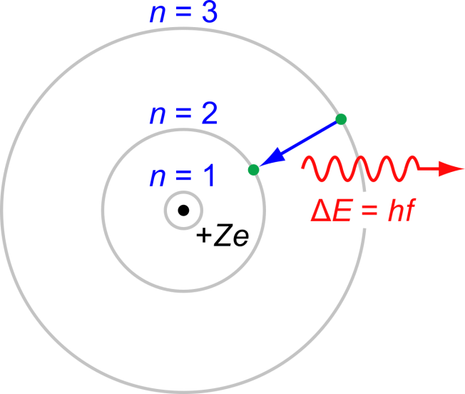
Discrete energy levels of electrons in an atom
Why do atoms emit light only with some particular frequencies?
Suggest that discrete energy levels of electrons in an atom.
https://commons.wikimedia.org/wiki/File:Bohr-atom-PAR.svg

Slide 13
Bohr model: discreteness of energy levels
Bohr explained discreteness of energy levels by introducing “wave nature” of an electron. ⇒ “Dawn of Quantum Mechanics”
Electron circular motion around the nucleus
At the end of the circular motion, electron wave must constructively interfere with itself to avoid vanishment of the wave.

Slide 14
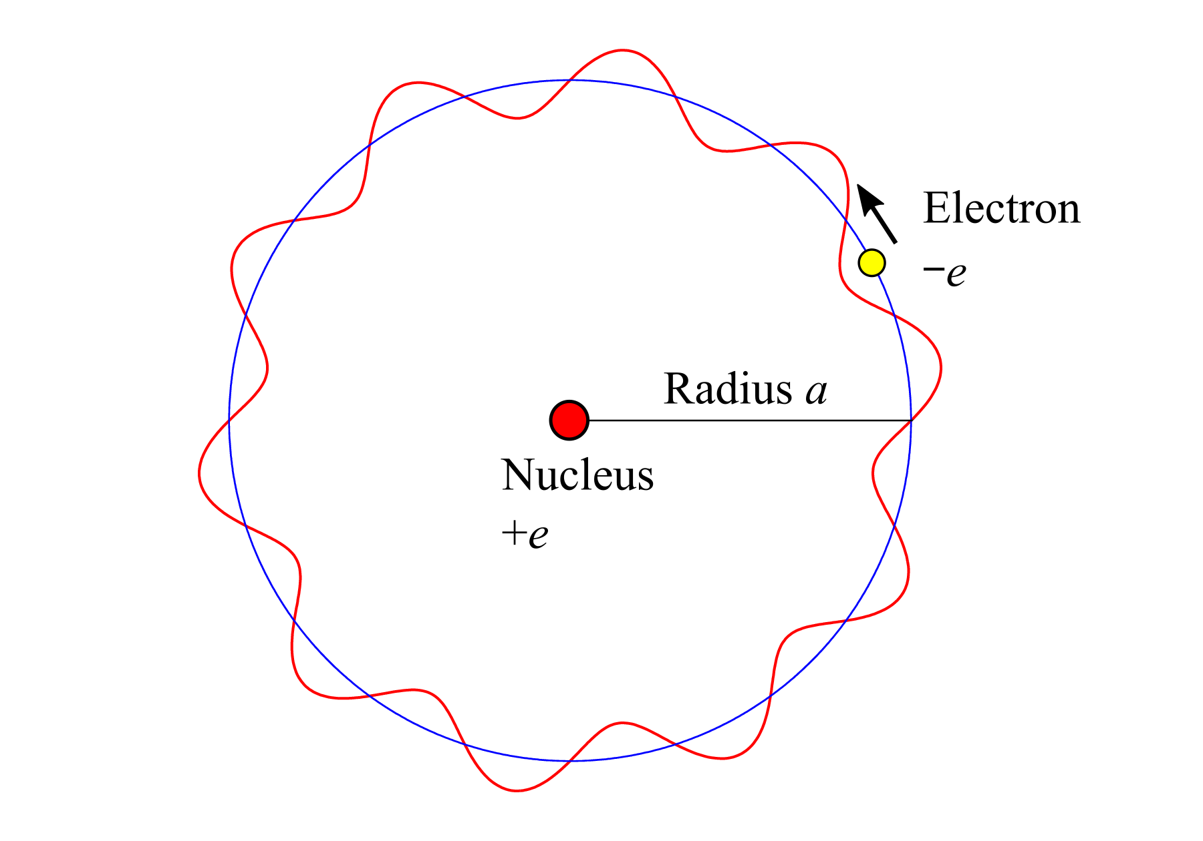
Energy levels based on Bohr model (Hydrogen atom)
Kinetic energy T & Potential energy U
Wavelength of an electron (de Bloglie wavelength)
Bohr’s quantization condition
EXERCISE: Express Rydberg constant in terms of e, m, ε0, and h.

Slide 15
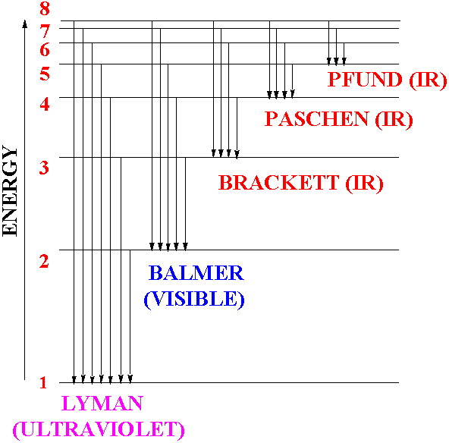
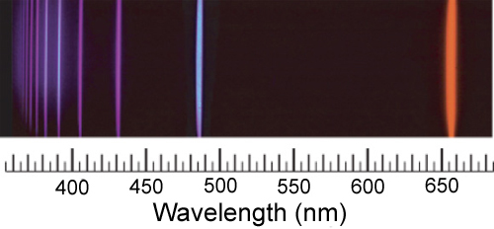
Spectrum of hydrogen atom
Energy levels Line spectrum
(Balmer series)
© T.W. Hänsch
http://chemweb.ucc.ie/courses/FLalor/
FJL%20Lecture%205_files/image002.gif

Slide 16
4. Optical memory
Magneto-optical memory (MO)
Utilizing magneto-optic effect
Magneto-optical (magneto-optic) effect
Polarization state of light is changed at reflection on the surface of, or passing through, a magneto-optical material exposed to external magnetic field.
Faraday effect, Magneto-optical Kerr effect

Slide 17
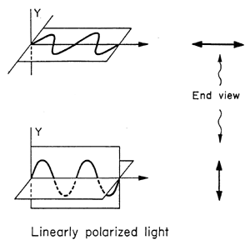
Polarization of light
x
Linear polarization of light
Electric field E is at right angle to the propagation direction.
⇒ Two independent
directions of E field
“Horizontal”
y
x
y
“Vertical”
http://www.optics4kids.org/home/content/other-resources/articles/polarized-light/

Slide 18
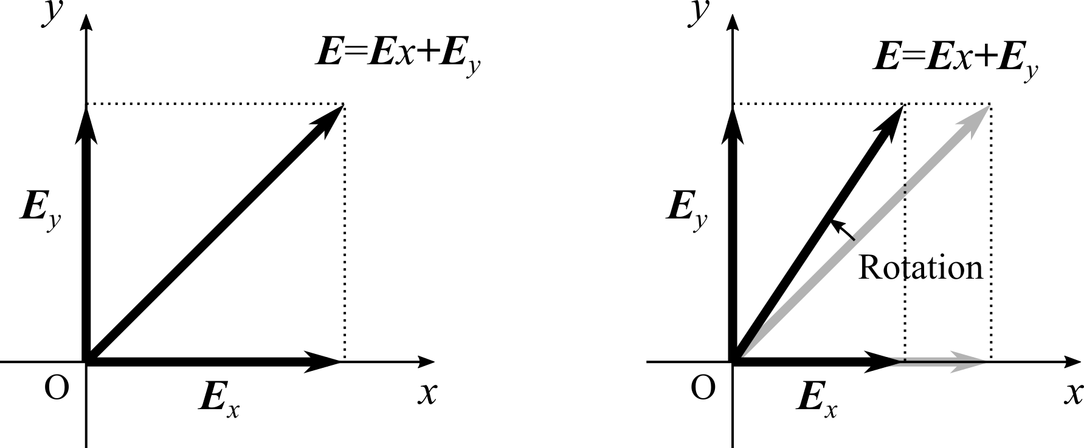
Rotation of linear polarization
If amplitudes of field components are changed, the direction of the total field is changed (rotated).

Slide 19
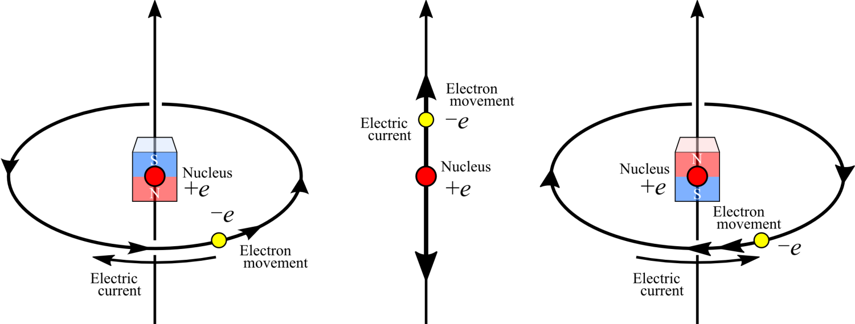
Zeeman effect
If atoms are exposed to external magnetic field, the resonance frequency ω₀ is changed.
Circularly moving electron (circular current) becomes a magnet.
Magnets with different directions have different energies in an external magnetic field.

Slide 20
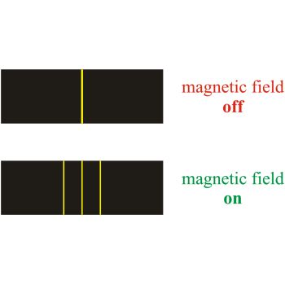
Zeeman effect and Zeeman splitting
Due to the different energies, spectral line is split into three spectral lines.
Three types of electron movement
(typical)
H
H
H
Increased energy No change Decreased energy
ω₀+Δω ω₀ ω₀-Δω
Interaction with
H-polarized light V-polarized light H-polarized light
http://glossary.periodni.com/
glossary.php?en=Zeeman+effect
EXERCISE: Calculate the potential energy of magnet in a magnetic field.

Slide 21
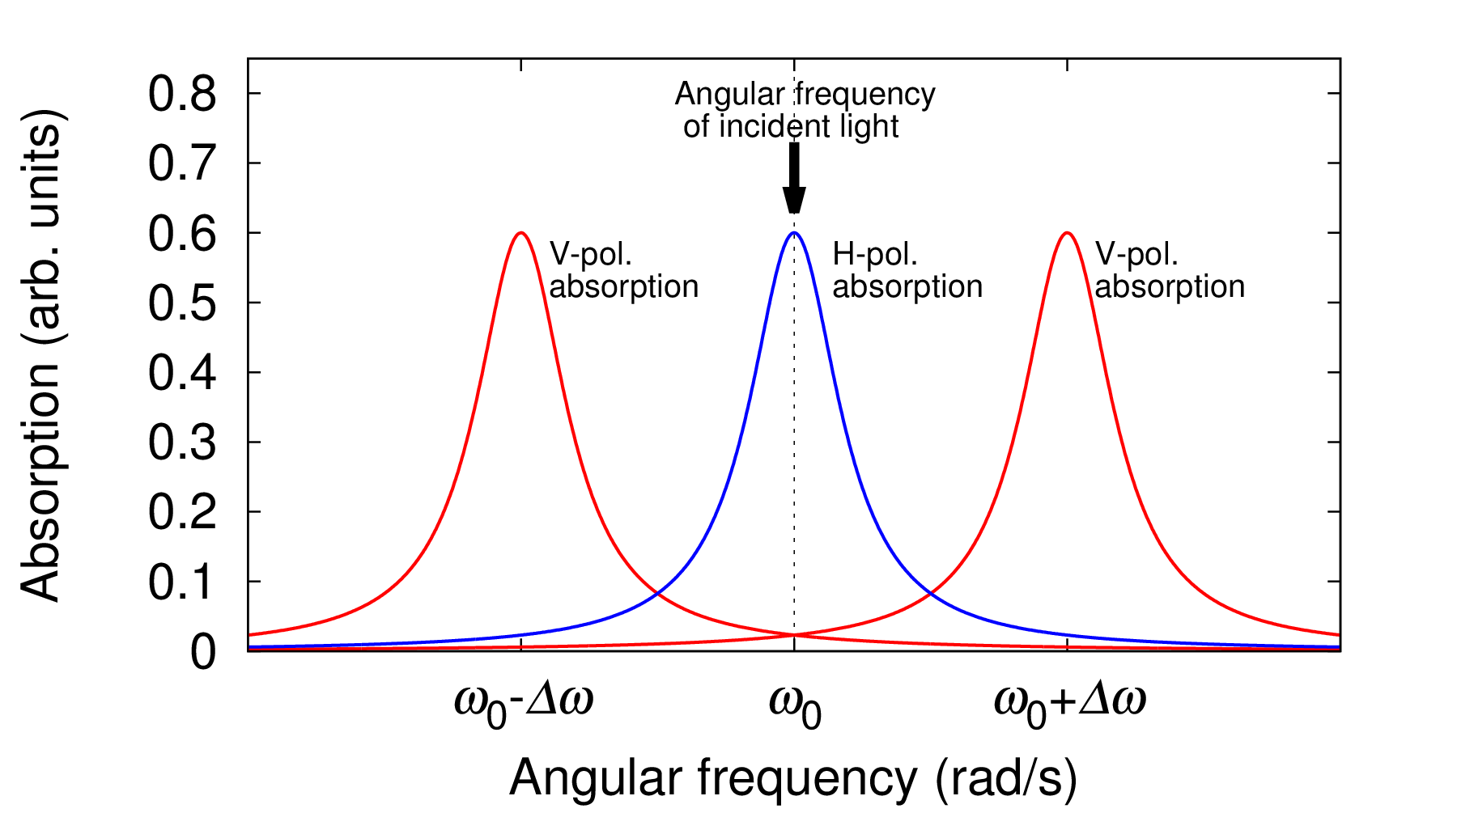
Absorption difference between H- and V-polarized lights
Only H-polarized light is absorbed!
Rotation of light polarization
“Magneto-optical effect”
Faraday effect:
passing through dielectric
Magneto-optical Kerr effect:
reflection at surface of dielectric

Slide 22
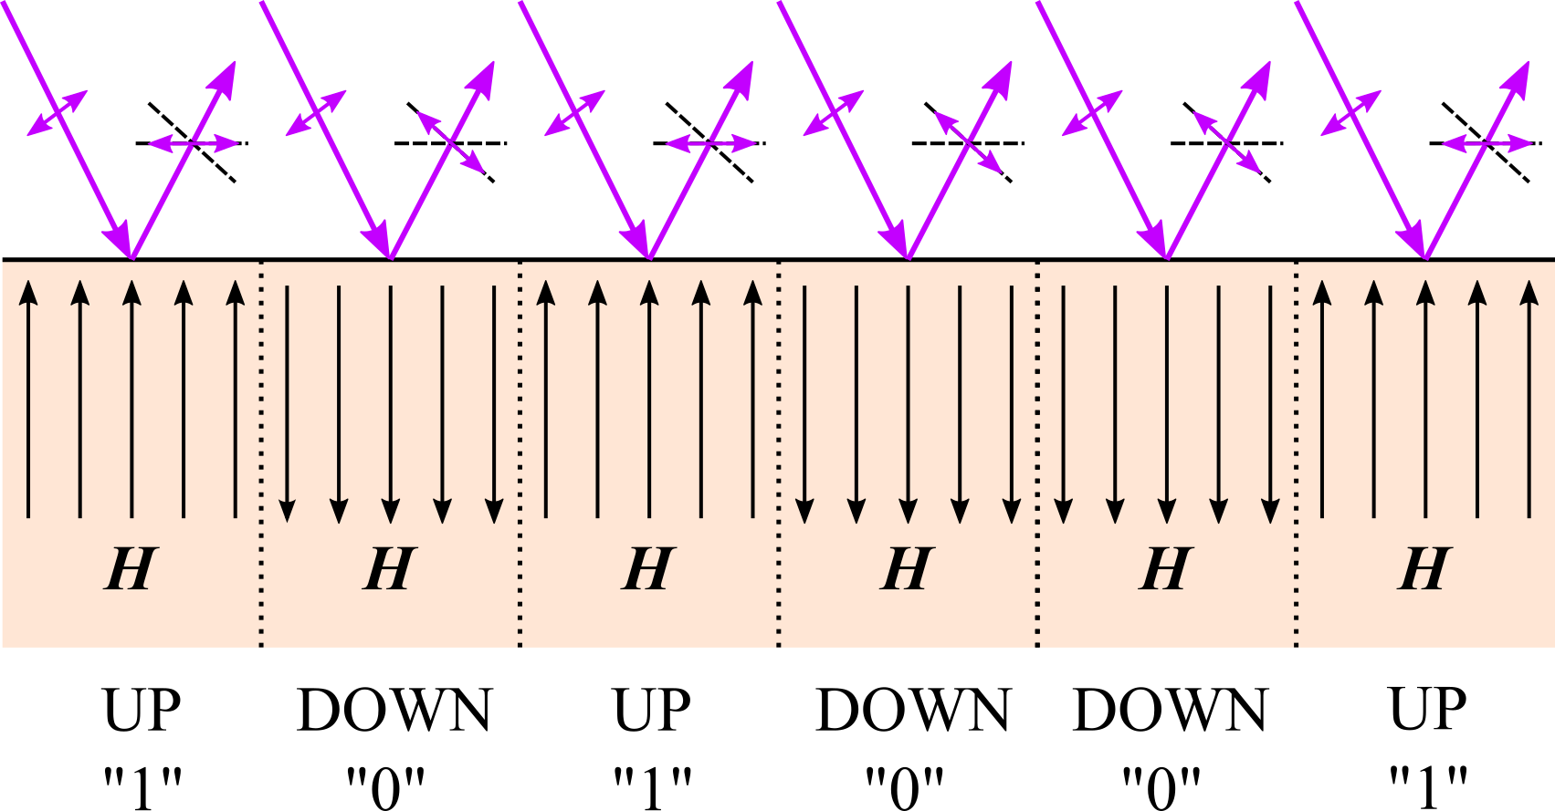
Magneto-optical memory
Magneto-optical Kerr effect
Polarization of reflected light flips or not, depending on whether H is up or down.
n” : imaginary part
「虚部」

Slide 23
Summary
Review of the last week
Mutual relation among optical, electric and atomic properties
Absorption and emission of light
Spectroscopy
Atomic resonance and Line spectrum
Optical memory
Magnetooptic effect
Faraday effect, Kerr effect

